Slide 1


Simple Retrieval Queries in MySQL Workbench
Your Instructor: Judy Richardson

Slide 2

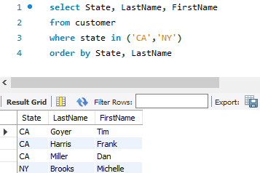
Example of a Query:

Slide 3

Task 1: Tables in MySQL Workbench
Simple Retrieval Queries in MySQL Workbench

Slide 4
Task 2: Queries in MySQL Workbench
Simple Retrieval Queries in MySQL Workbench

Slide 5
What is a retrieval query?
A user has a request/requirement
Show me a list of customers from California
A query is the SQL code
that retrieves data from the database
and produces the output to satisfy that request

Slide 6
What can a retrieval query do?
It fetches/reads/retrieves data from a table and displays it according to our instructions.
It cannot modify the layout of a table.
It cannot add, delete, or modify data in a table.

Slide 7
Embedded Queries
An SQL query can be embedded into another programming language.
SQL fetches the data, while the other language formats it on a web page.

Slide 8
Task 3: The SELECT Statement
Simple Retrieval Queries in MySQL Workbench

Slide 9
SELECT statement
The SQL statement that begins a retrieval query
Specifies the columns requested
Using “*” indicates all columns
Includes a FROM clause to specify the table

Slide 10
SELECT statement
Controls which columns appear in the results
Controls the order in which the columns appear

Slide 11
Task 4: The WHERE Clause
Simple Retrieval Queries in MySQL Workbench

Slide 12
WHERE Clause
Controls which rows appear in the results
Data values are case sensitive in most DBMS

Slide 13
Comparison Operators
 | Description
< | Less than
> | Greater than
<= | Less than or equal to
>= | Greater than or equal to

Slide 14
More Comparison Operators
 | Description
Between…and | Range of values
Is null | Contains a null value
Is not null | Doesn’t contain a null value
like | Is similar to

Slide 15
Your turn:
select invoiceid, total, invoicedate
from invoice
where invoicedate between
'2010-07-01' and '2010-09-30'

Slide 16
Your turn:
select company, address, city, state, country
from customer
where company is not null

Slide 17
Task 5: The Combination WHERE Clause
Simple Retrieval Queries in MySQL Workbench

Slide 18
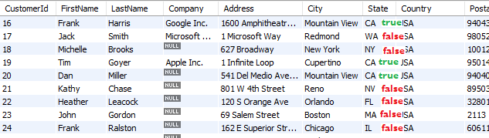
Testing a WHERE condition
One row at a time…

Slide 19
Logical Operators
 | Description
and | All of the conditions must be true
or | At least one of the conditions must be true

Slide 20
Logical Operators
select customerid, billingcountry, total
from invoice
where BillingCountry = 'France'
or BillingCountry = 'Ireland’
and total > 5

Slide 21
Logical Operators
select customerid, billingcountry, total
from invoice
where (BillingCountry = 'France'
or BillingCountry = 'Ireland’)
and total > 5

Slide 22
Task 6: The ORDER BY Clause
Simple Retrieval Queries in MySQL Workbench

Slide 23
Order of the rows
Rows are typically stored in the order in which they were input.
Sorting only changes the way they display in the result grid.

Slide 24
About sorting
You can sort by a column that isn’t in the SELECT statement.
You can sort by multiple columns.
You can combine sorting with filtering.

Slide 25
Sample Sort and Filter
select CustomerID, BillingCountry, Total
from invoice
where BillingCountry in
('Norway','USA','Ireland')
and total < 10
order by billingcountry, total desc

Slide 26
Task 7: Temporary Columns
Simple Retrieval Queries in MySQL Workbench

Slide 27
Calculating a New Field
Does the calculation on each row
Displays the calculation result as a new column
Does NOT change the contents of the table

Slide 28
Calculating a New Field
SELECT CustomerID, Total,
(Total * .9) as 'Discounted Total’
from Invoice
where invoicedate between
'2013-12-01' and '2013-12-30'

Slide 29
Summary:
SELECT – determines columns
WHERE – determines rows
ORDER BY – determines sequence
Calculated Columns – provide temporary data columns

Slide 30

Congratulations on completing
Simple Retrieval Queries in MySQL Workbench

